Slide 1
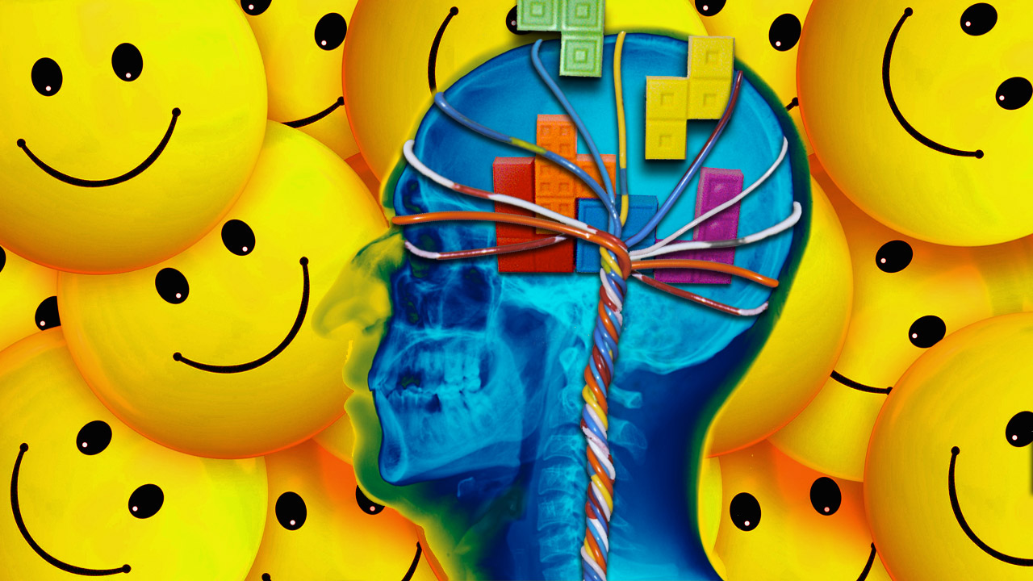
Positive Psychology
An Introduction

Slide 2
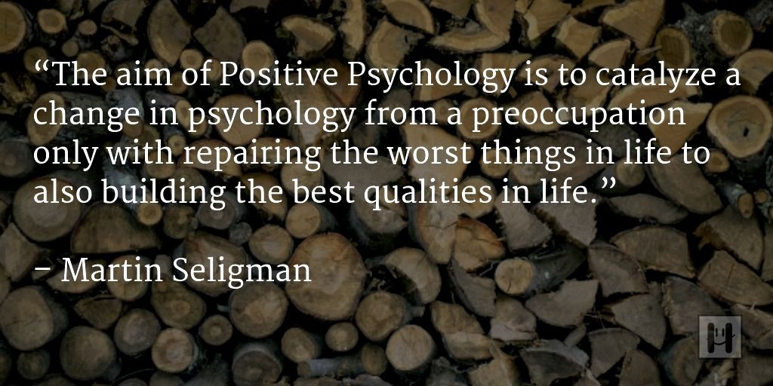

Slide 3
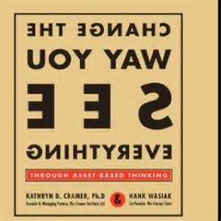

Slide 4
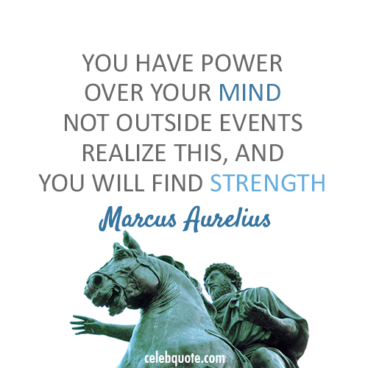

Slide 5
Positive Psychology
The scientific study of positive human functioning and flourishing on multiple levels that include the biological, personal, relational, institutional, cultural, and global dimensions of life
--Seligman and Csikszentmihalyi

Slide 6
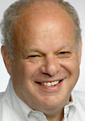
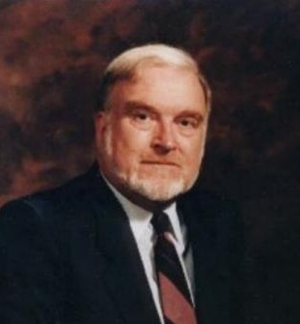
Positive Psychology
Everyday language: The scientific study of what makes life most worth living
Concerned with eudaimonia, or "the good life," a reflection about what holds the greatest value in life – the factors that contribute the most to a well-lived and fulfilling life.

Slide 7
Historical overview
Before World War II emphasis on curing illness, making life more fulfilling, and nurturing talent…
1947 NIMH shifted focus to research into pathology
Human beings came to be seen as passive

Slide 8
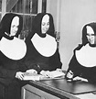
School Sisters of Notre Dame 1932
Ceclia O’Payne Autobiographical sketch
“God started my life off well by bestowing upon me grace of inestimable value…The past year which I spent as a candidate studying at Notre Dame has been a very happy one. Now I look forward with eager joy to receiving the Holy Habit of Our Lady and to a life of union with Love Divine.”

Slide 9
School Sisters of Notre Dame 1932
Marguerite Donnelly Autobiographical sketch
“I was born on September 26, 1909, the eldest of seven children, five girls and two boys…My candidate year was spent in the motherhouse, teaching chemistry and second year Latin at Notre Dame Institute. With God’s grace, I intend to do my best for our Order, for the spread of religion and for my personal sanctification.”

Slide 10
School Sisters of Notre Dame 1932
Sketches were rated in the amount of positive feeling
Most cheerful quarter: 90% alive at age 85, 54% at age 94
Least cheerful quarter: 34% alive at age 85, 11% at age 94
Cecilia O’Payne (lived over 98 years)
Marguerite Donnelly (died at 59)

Slide 11

PsycInfo Research Papers
Clinical Psychology
Anger 31,260
Anxiety 243,516
Depression 299,809
As of July 2018
Positive Psychology
Joy 8,762
Happiness 17,716
Life satisfaction 22,436
Mindfulness 11,414
Note: Mindfulness increased the most in the last year…21% increase vs 6-8% in other categories

Slide 12
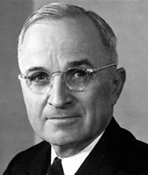
Thoughts from Seligman
Need a psychology of rising to the occasion…thought of this as a missing piece in the jigsaw puzzle of predicting human behavior
We measure behavior in absence of real-world challenges, and try to predict what a person would do
Correlation between IQ and performance…but some people with high IQ fail, and some with lower IQ succeed life challenges
Harry Truman effect
We have all strengths we may not
even know about until we are challenged

Slide 13
Guiding Theories in Positive Psychology
Seligman’s PERMA
Seligman and Peterson's Character Strengths and Virtues
Csikszentmihalyi's theory of Flow

Slide 14
Seligman’s shift
Where did the shift from pathology to prevention come from?
Seligman known for research on learned helplessness
BUT…not all rats and dogs became helpless, not all people became helpless with insolvable problems or inescapable noise
1 out of 3 never gives up!
And…1 out of 8 is helpless to begin with

Slide 15
What Is Positive Psychology?
Balancing foci of Applied Psychology:
-What
Martin Seligman on the State of Psychology
(See “Building Human Strength: Psychology’s Forgotten Mission” by Seligman, p. 4-5)
What is wrong with people
(study of deficits)
What is right with people
(study of assets)

Slide 16
PERMA

Slide 17
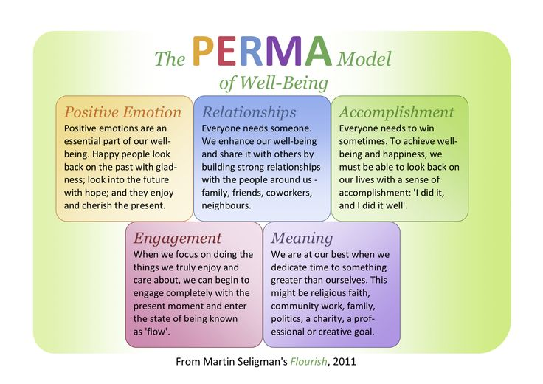

Slide 18
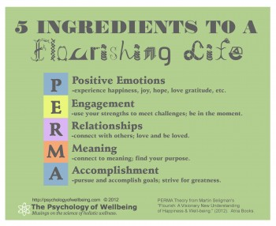
Flourishing
Content of Flourishing: happiness, flow, meaning, love, gratitude, accomplishment, growth, better relationships
PERMA
Positive Emotions
Engagement
Social Relationships
Meaningfulness
Achievement

Slide 19
Positive Emotions
AKA Pleasant Life
Contributes to well-being (In Authentic Happiness Theory, it was the cornerstone of the theory
Happiness and life satisfaction
Measured subjectively
Includes variables of pleasure, ecstasy, comfort, warmth, and the like

Slide 20
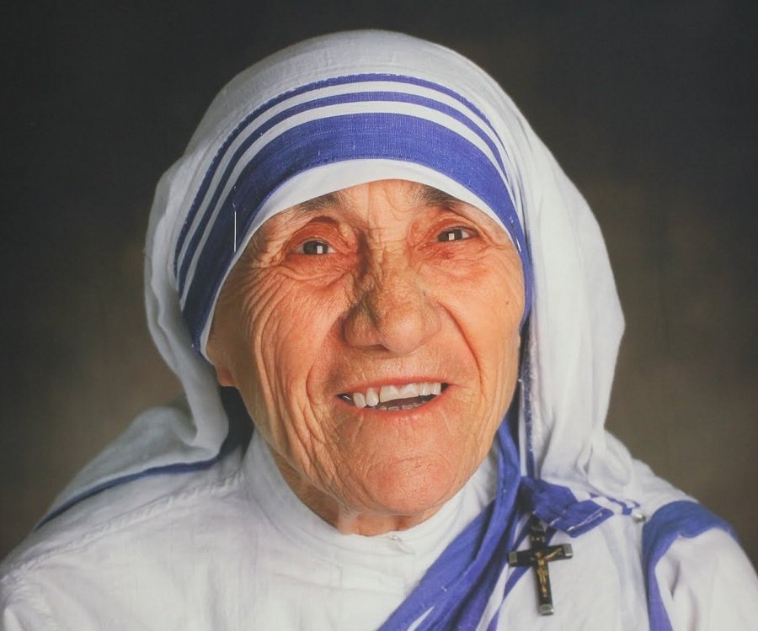
Quote
“Be happy in the moment, that's enough. Each moment is all we need, not more.” ― Mother Teresa

Slide 21
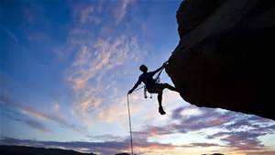
Engagement
AKA Flow
Measured subjectively
Did time stop for you?
Were you completely absorbed by the task?
Did you lose self-consciousness?
Subjective state for engagement is retrospective…since when we are in a flow state
Flow: when our skills are challenged

Slide 22
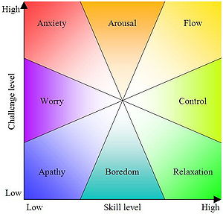

Slide 23
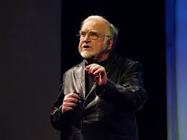
Flow
Flow Talk on Ted

Slide 24
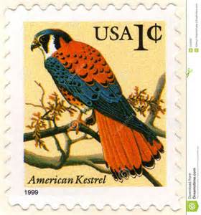
Positive Relationships
Research: doing a kind thing for another produces the single most reliable momentary increase in well-being of any exercise tested
Seligman stamp example
George Valliant: master strength is the capacity to be loved

Slide 25
Meaning
AKA Meaningful Life
Belonging to and serving something that you believe is bigger than the self

Slide 26
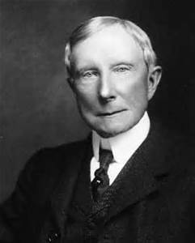
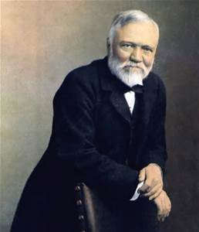
Accomplishment
AKA Achieving Life
Idea that we pursue success, accomplishment, winning, achievement and mastery for their own sakes
Pursuit may not bring positive emotion or meaning, or positive relationships
Tycoons turned philanthropists: Andrew Carnegie, John D. Rockefeller, Bill Gates (created meaning later in life)
“accumulators” or play to win

Slide 27
Flourishing and Strengths

Slide 28
Flourish and Strengths
24 Strengths
Strengths underpin all five elements
Deploying your highest strengths leads to more positive emotion, to more meaning, to more accomplishment, and to better relationships

Slide 29
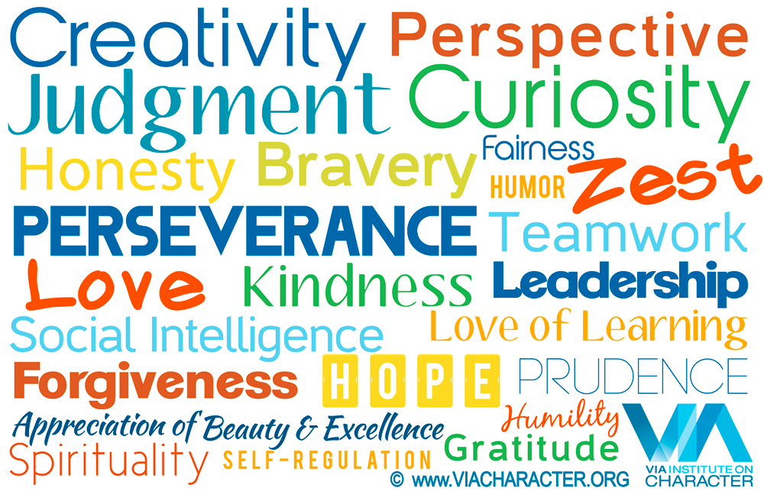
Strengths
http://www.viacharacter.org/www/Character-Strengths/VIA-Classification

Slide 30
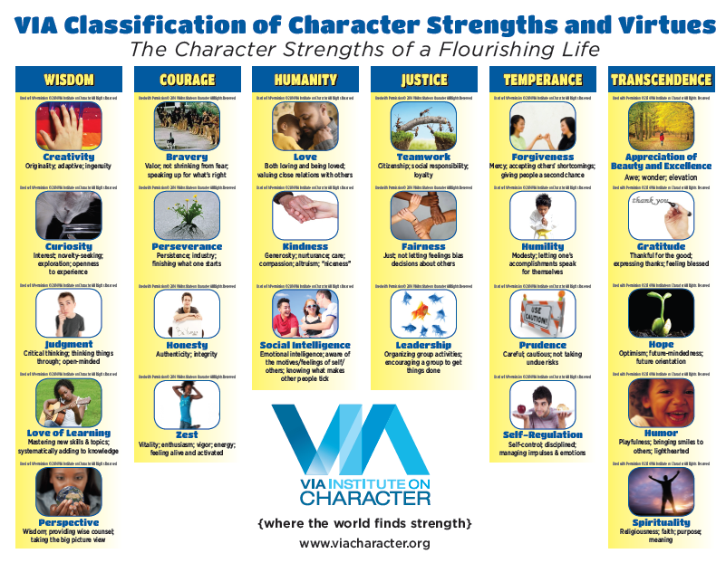

Slide 31
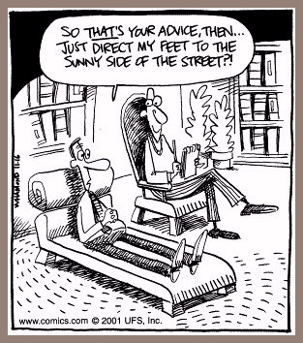

Slide 32
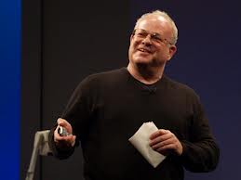
Martin Seligman
Martin Seligman Ted Talk

Slide 33
Positive Psychotherapy Exercises and Tools
Gratitude Journal
Design a Beautiful Day
Self Esteem Journal
Values in Action Survey
Mindfulness Meditation

Slide 34
Gratitude Journal
Be specific
Focus on people
See good things as gifts
Savor surprises
Revise if you repeat something
Write regularly (some recent research suggests 3x/week is ideal
Write in journal up to 5 things for which you are grateful
Can be small in importance (e.g., sunshine) to large (e.g., I got my dream job)

Slide 35

Mindfulness

Slide 36
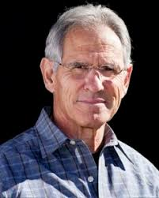
Mindfulness
The practice has moved from a largely obscure Buddhist concept founded about 2,600 years ago to a mainstream psychotherapy construct today (apa.org)

Slide 37
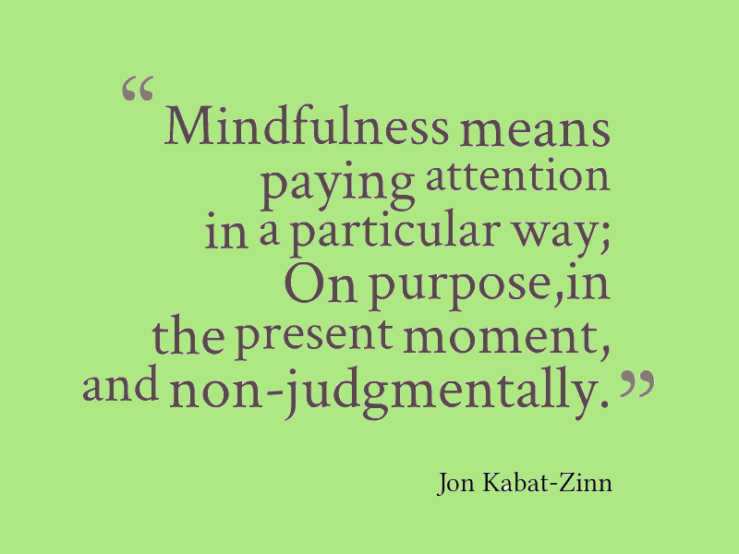

Slide 38
Benefits of Mindfulness
Self-control
Objectivity
Attention
Memory
Emotional intelligence
Less anxiety
Improved concentration and mental clarity
The ability to relate to others and one's self with kindness, acceptance and compassion.

Slide 39
Welcome to Positive Psychology
Scientific study of ordinary human strength and virtues
Helps people find what is best within themselves
Enhances their experiences in work and relations

Slide 40
The Dimensions of Positive Psychology: 3 Levels
Subjective level
Focuses on positive emotions and constructive thoughts
Individual level
Focuses on positive behavior pattern and individual creative potential.
Society level
Work on development of civic virtues as well as support and nurture citizens.
Notes:
Subjective level: Focuses on positive emotions and constructive thoughts.
Individual level: Focuses on positive behavior pattern and individual creative potential.
Society level: Work on development of civic virtues as well as support and nurture citizens.

Slide 41
The Scope of Positive Psychology
List of interests
Building enriching communities, compassion, creativity, and empathy
Enhancement of immune system and functioning
Life span models of positive personality development
Psychological benefits of Zen meditation

Slide 42
Basic Themes of Positive Psychology
The Good Life (Combination of three elements)
Connections with others
Positive individual traits
e.g., Integrity, creativity, courage
Life regulation qualities
Regulate behavior to accomplish goals while interacting with the world

Slide 43
Basic Themes of Positive Psychology
Positive Emotions Are Important
Focus working on positive emotions rather than negative emotions
Helps people emerge from debilitating psychological problems…use adaptive coping
Self-help interventions based on positive psychology
Notes:
Self-help interventions based on positive psychology: Help increase positive mood and well-being.
Conclusion: More positive emotions, more success.

Slide 44
Importance of Positive Emotions
Positive emotions related to…
Attaining goals
Physically healthier
More resistant to illness
Live longer!

Slide 45
Basic Themes of Positive Psychology
People Can Flourish and Thrive
Classification of mental health
Flourishing
Struggling
Floundering
Languishing
Notes:
Corey L. M. Keyes and Shane Lopez (2002) created a classification system that has yielded one of the basic terms in positive psychology.
Flourishing: High on well-being and low on mental illness are flourishing
Struggling: High well-being and high on mental illness are struggling
Floundering: Low on well-being but high on mental illness symptoms are floundering
Languishing: Low well-being and low on mental illness are languishing

Slide 46
Basic Themes of Positive Psychology
People Can Flourish and Thrive
Complete health comprises
High emotional well-being
High psychological well-being
High social well-being
Low mental illness

Slide 47
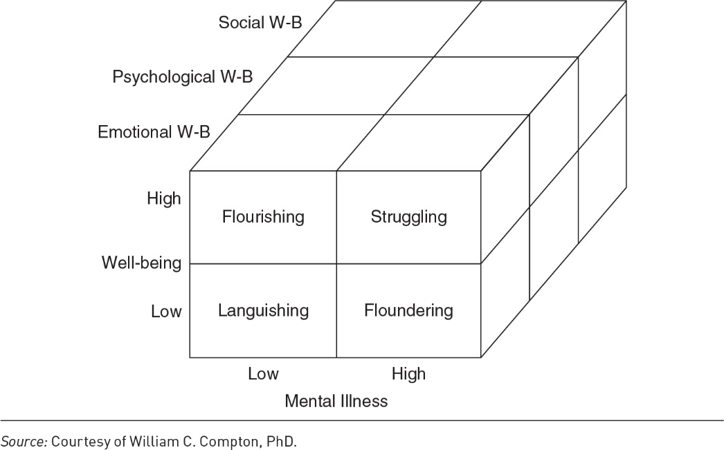
Basic Themes of Positive Psychology
Notes:
Social well-being: social acceptance, actualization, contribution, coherence, integration
Psychological well-being: feel competent, autonomous, and self-accepting; have purpose in life; exhibit personal groth; and enjoy positive relationships with others
Emotional well-being: happy, satisfied

Slide 48
Basic Themes of Positive Psychology
People Need Positive Social Relationships
Teach children about nature of happiness, good life
Consider happiness achievable through individual effort
Enhance understanding of how people experience psychological well-being

Slide 49
Basic Themes of Positive Psychology
Strengths and Virtues Are Important
Values like courage, fidelity, and honesty
Scientifically discover values that enhance the quality of life

Slide 50
Basic Themes of Positive Psychology
Compassion and Empathy Are Important
Capacity for empathy associated with life satisfaction and positive relationships
Motivate people to overcome low self-esteem by helping others

Slide 51
Basic Themes of Positive Psychology
Independence of Positive and Negative Emotions
Optimism and pessimism have differential effects on a person’s self-reported well-being
Dynamic model of affect…independence of positive and negative emotions depends on the situation
Sometimes positive and negative emotions “fuse,” such as when we are under stress or uncertainty
Notes:
Dynamic model of affect: Independence of positive and negative emotions depends on the situation
Unique psychological processes: Help a person move from feeling negative emotions to neutral emotionality
Other psychological processes that help someone move from neutral emotionality to greater happiness

Slide 52
Basic Themes of Positive Psychology
Negative Emotions Are Still Important
Negative emotions are vital to self-understanding and personal growth
Research says happiness may be necessary to the good life but not sufficient
Increase one’s quality of life is to help others increase their level of happiness and life satisfaction.

Slide 53
Basic Themes of Positive Psychology
The Science of Well-being
Study healthy personality development and optimal states of well-being
Need to build an experimental knowledge base in the psychological laboratory

Slide 54
A Short History of Well-being in the Western World
Hedonism
Only pleasure or displeasure motivates us
Arguments for psychological hedonism
Arguments against psychological hedonism
The Early Hebrews
Influenced Western culture--along with Greek civilization and Christianity
Notes:
Hedonism: The oldest approach to well-being and happiness and emphasizes pursuing pleasure and avoiding pain.

Slide 55
A Short History of Well-being in the Western World
The Greeks
Set the stage for developments in philosophy, science, art, and psychology

Slide 56
A Short History of Well-being in the Western World
The Greeks: Socrates
True happiness could be achieved only through self-knowledge
Know the good or the core elements of the good life

Slide 57
A Short History of Well-being in the Western World
The Greeks: Plato
Ancient Greek philosopher;
Student of Socrates, teacher of Aristotle.
Theme of research--
Conflict between nature and convention
Role of heredity and environment on human intelligence

Slide 58
A Short History of Well-being in the Western World
The Greeks: Aristotle
Work influenced by Socrates
Discussion of principle of eudemonia
Proposition of 12 basic virtues leads to virtue theory

Slide 59
A Short History of Well-being in the Western World
The Greeks: The Epicureans
Founders of school of Epicureanism
Pleasures can be achieved by avoiding unnecessary pains

Slide 60
A Short History of Well-being in the Western World
The Greeks: The Summary of Greek Ideas on the Good Life
Four major theories
The contemplative life
The active life
The fatalistic life
Hedonism

Slide 61
A Short History of Well-being in the Western World
The Greeks: The Summary of Greek Ideas on the Good Life
Two additional perspectives on the good life
The heroic life
The saintly life

Slide 62
A Short History of Well-being in the Western World
Early Christianity and the Middle Ages
Christianity also transformed the meaning of religious devotion in the West
The Virtue Theory in the Middle Ages
Seven deadly sins
Four cardinal virtues and three theological virtues
Notes:
Seven deadly sins: Anger, envy, greed, intemperance, lust, pride, and sloth

Slide 63
A Short History of Well-being in the Western World
Early Christianity and the Middle Ages: Moses Maimonides
Renowned Jewish religious leader, philosopher, and physician in Egypt
Advocated the practice of mindfulness as vital to healthy functioning
Encouraged the development of positive character traits
Notes:
Moses Maimonides:

Slide 64
A Short History of Well-being in the Western World
The Renaissance to the Age of Enlightenment: The Rise of Science
Universe as a whole is one vast machine
Western intellectual life became modern in mood, temper, purpose, and presupposition

Slide 65
A Short History of Well-being in the Western World
The Renaissance to the Age of Enlightenment: The Rise of Democracy
All men are created equal: they are endowed by their Creator with certain inalienable rights
The action of happiness became a right as well as a personal choice

Slide 66
A Short History of Well-being in the Western World
Romanticism and the 19th Century: Emotion and the Romantics
Express individualism
The Romantic movement
Ability to feel emotions intensely was important to living a full and significant life
Notes:
Romantic movement: It captures the excitement of the intelligentsia as they explored the full range of their emotional life from the spiritual to the mundane.

Slide 67
A Short History of Well-being in the Western World
Romanticism and the 19th Century: Love in the Romantic Period
The romantic love in different countries

Slide 68
A Short History of Well-being in the Western World
Romanticism and the 19th Century: Celebrating Childhood Experience
Emphasizes the importance of exposing children to nature and encouraging their individual self-expression

Slide 69
A Short History of Well-being in the Western World
The 20th Century: Humanistic Psychology
Differences between humanistic psychology and positive psychology
Western psychology and Eastern psychology in the 20th century

Slide 70
Positive Psychology Today
Positive psychology extensively covered in professional journals
Special focus on studying topics relevant to positive human functioning
Positive psychology has a permanent place in scientific psychology

